Slide 1

COMP7500/7506 Advanced Operating Systems
Multilevel Queue Scheduling
Dr. Xiao Qin
Auburn University http://www.eng.auburn.edu/~xqin
xqin@auburn.edu
Notes:
2019 Spring
5 Minutes for demo. No time for Ex6, Ex7, and Ex8.
2018 Spring
48 Minutes: Slides 1-17 including the magic show.

Slide 2

Wait Time vs. Turnaround Time
Let P = {p_{i} | 0 ≤ i < n} = set of processes
Let S(p_{i}) ∈ {running, ready, blocked}
Let t(p_{i}) = Time process needs to be in running state (the service time)
Let W(p_{i}) = Time p_{i} is in ready state before first transition to running (wait time)
Let T_{TRnd}(p_{i}) = Time from p_{i} first enter ready to
last exit ready (turnaround time)
Batch Throughput rate = inverse of avg T_{TRnd}
Timesharing response time = W(p_{i})

Slide 3
Exercise 6 (Menti): The system objectives of processor scheduling include the following ones except:
Reduce wait time
Improve throughput
Minimize context switch overhead
Optimize processor efficiency
Notes:
See also “Reduce response time”

Slide 4
Exercise 7 (Menti): The shortest job next scheduling algorithm schedules the following five jobs. (7.1) What is the average turn around time? A. 315 B. 600 C. 560 D. 480 (7.2) What is the average waiting time? A. 285 B. 320 C. 410 D. 305 i 0 1 2 3 4 t(pi) 350, 125, 475, 250, 75
Notes:
Time out
Wait for I/Os
Be preempted
Done
Wait for event (synchronization)

Slide 5
Review: Basic Concepts
1
2
What is turn-round time?
What is waiting time?
3
What is the throughput?
Notes:
Batch Throughput rate = inverse of avg T_{TRnd}

Slide 6
Exercise 1 (Menti): If a scheduler offers an average turn-round time of 20 second, what is the throughput of this scheduler?
0.5 No./Second
0.05 No./Second
0.5 Second/No.
20 Second/No.
Notes:
See also “Reduce response time”

Slide 7
Exercise 2: (2.1) Please propose two separate ready queues. (Hint: for different types of tasks) (2.2) What are scheduling policies these two queues?
Multilevel Queue: Partition a ready queue into two queues.
Interactive
Queue
Real-Time
Queue
Large-Job
Queue
Batch
Queue
Non-Real-Time Queue
Small-Job
Queue
Notes:
Ready queue is partitioned into separate queues, eg:
foreground (interactive)
background (batch)
Process permanently in a given queue
Each queue has its own scheduling algorithm:
foreground – RR
background – FCFS
Scheduling must be done between the queues:
Fixed priority scheduling; (i.e., serve all from foreground then from background). Possibility of starvation.
Time slice – each queue gets a certain amount of CPU time which it can schedule amongst its processes; i.e., 80% to foreground in RR
20% to background in FCFS

Slide 8
Multilevel Queue
Ready queue is partitioned into two queues:
foreground (interactive)
background (batch)
Process permanently in a given queue
Each queue has its own scheduling policy:
foreground – RR
background – FCFS
How to come up with research ideas?
Notes:
New research ideas?
Change computing platform from one into another.
For example, consider new platforms like
GPUs
IoTs
Hadoop
Storm
Spark
In-memory computing
From two queues into three queues or four queues

Slide 9
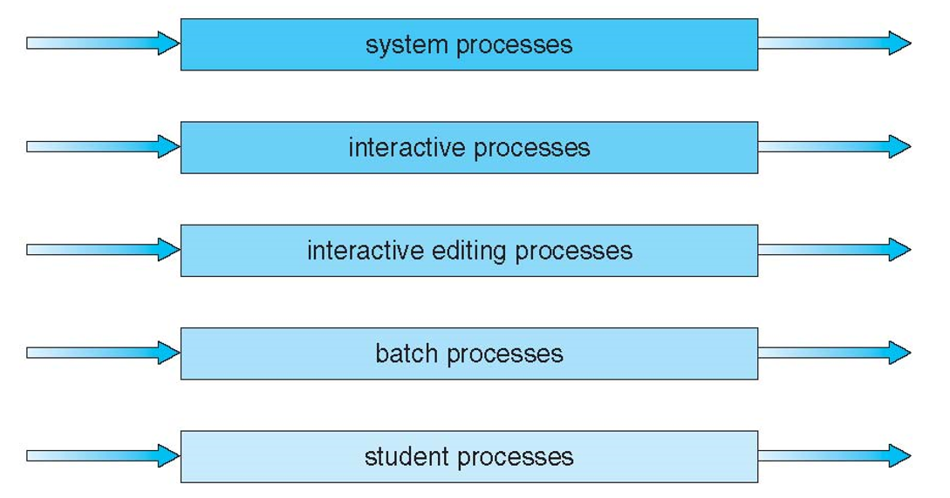
Exercise 3: In multi-level queue scheduling, which queue has the highest priority and which one has the lowest one?
Highest
How does it
work?
Lowest
Notes:
Reference Slide: p. 25
Question: how does this multi-level queue scheduling policy work? Pick a process from one queue is there is no process in a higher-priority queue.

Slide 10
Exercise 4 (Group Discussion): How to schedule between two queues?
Fixed priority scheduling: serve all from foreground then from background.
Time slice: each queue gets a certain amount of CPU time scheduled amongst its processes
Possibility of
starvation.
80%: foreground in RR
20%: background in FCFS

Slide 11
A Meta Scheduler
Meta scheduler
Time slices
IJ/BJ
How should the two schedulers share CPU time?
Q
Q
Scheduler for Interactive jobs
(Round Robin)
Scheduler for batch jobs
Priority FCFS
ready_q
ready_q
PCB₁
PCB₂
…
PCB_{n}
PCB₁
PCB₂
…
PCB_{n}
Notes:
Meta-scheduling or Super scheduling is a computer software technique of optimizing computational workloads by combining an organization's multiple Distributed Resource Managers into a single aggregated view, allowing batch jobs to be directed to the best location for execution.

Slide 12
Multilevel Feedback Queue
Processes can move between various queues
Notes:
Reference Slide: p. 26
Aging can be implemented this way

Slide 13
Exercise 5: Please setup the following parameters for a multilevel-feedback-queue scheduler
The number of queues: ________________
Scheduling algorithm for each queue? Yes or No
Method used to determine when to __________ a process
Method used to determine when to __________ a process
Method used to determine __________ a process will enter when that process needs service
Notes:
number of queues
scheduling algorithms for each queue
method used to determine when to upgrade a process
method used to determine when to demote a process
method used to determine which queue a process will enter when that process needs service

Slide 14
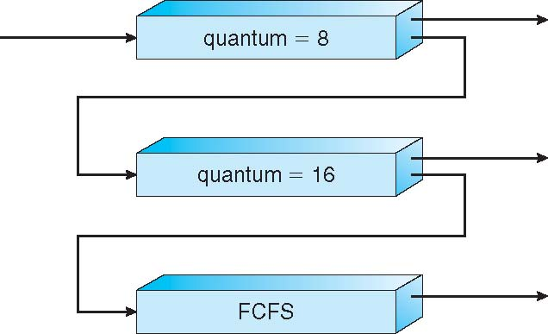

A Multilevel-Feedback-Queue Scheduler
Queue 1
Queue 2
Basic Idea
Queue 3

Slide 15
Exercise 6 (Plickers): A Multilevel-Feedback-Queue Scheduler
Queue 1
Which queue has the highest priority? Which queue has the lowest priority?
Queue 2
Queue 3

Slide 16
Exercise 7 (Plickers): Which statement is incorrect?
Processes in Queue 1 may starve
Processes in Queue 2 may starve
Processes in Queue 3 may starve
No starvation
Queue 1
Queue 2
Queue 3

Slide 17

Exercise 8: Please propose a solution to the starvation problem in a multilevel-feedback-queue scheduler.
.
Queue 1
Queue 2
Queue 3

Slide 18
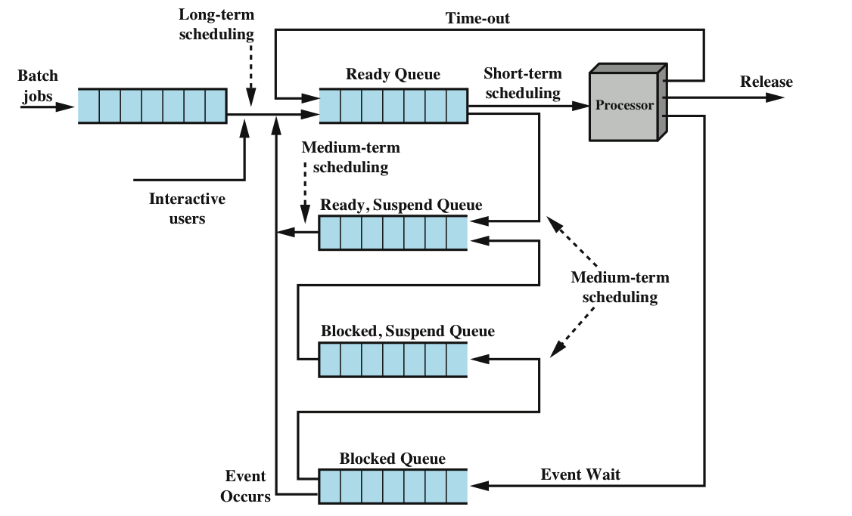
A Scheduling Mechanism vs. Scheduling Policies
Design Pattern
Notes:
Policy: a set of ideas or a plan of what to do. Mechanism: a process, technique, or system for achieving a result. A mechanism is more about 'how' a particular task (possibly a policy) is done where as a policy is more about 'what' needs to be done.

Slide 19
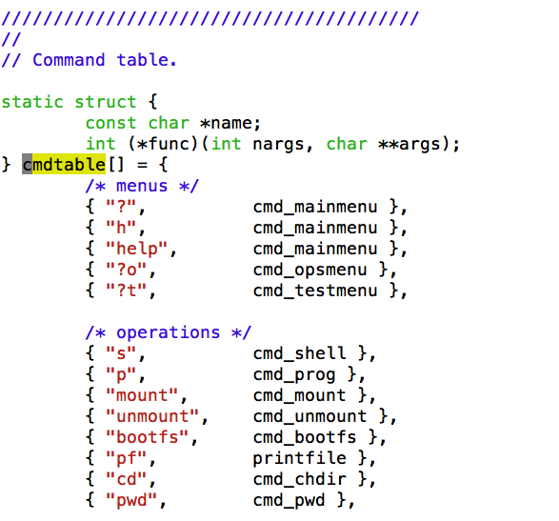
An Example of Separating
Policies from Mechanisms.
Design Pattern

Slide 20
Demonstration Separation of a Scheduling Mechanism from Scheduling Policies
Scheduling Policies
Scheduling Mechanism

Slide 21

Summary
What is multilevel queue scheduling?
Can you list various types of processes?
What is multilevel feedback queue scheduling?
Separate polices from a mechanism
Reading Assignment: Chapter 6.3.5 and 6.3.6 pp. 273-277.
Notes:
Cont. ch3.ppt, slide 44 Synchronization

